Slide 1
Building Material - Quality Control in Concrete case study analysis
By - Varshini Sree J K

Slide 2
PROBLEM STATEMENT AND OBJECTIVE
PROBLEM STATEMENT :
Enhancing the compressive strength analysis for Concrete in order to provide quality improvement
In the context of a construction aggregates company, there exists a challenge in maintaining consistent concrete compressive strength, leading to complaints from existing clientele and hindering sales efforts. The sales representative, Smith, seeks to address this issue by collaborating with Claire, the manager of analytics, to conduct an in-depth analysis of the factors affecting concrete compressive strength.
OBJECTIVE : The idea behind the analysis is that Smith needs to identify the factors that are causing inconsistency in Concrete Compressive Strength in the company
ROLES :
Andrew – Plant supervisor
Smith – Sales representative
Claire – Manager of Analytics

Slide 3
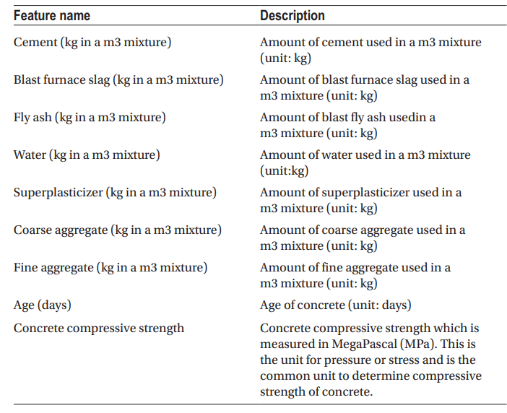
UNDERSTANDING THE DATA
FEATURES OF THE DATA SET – Concrete_Data.csv

Slide 4
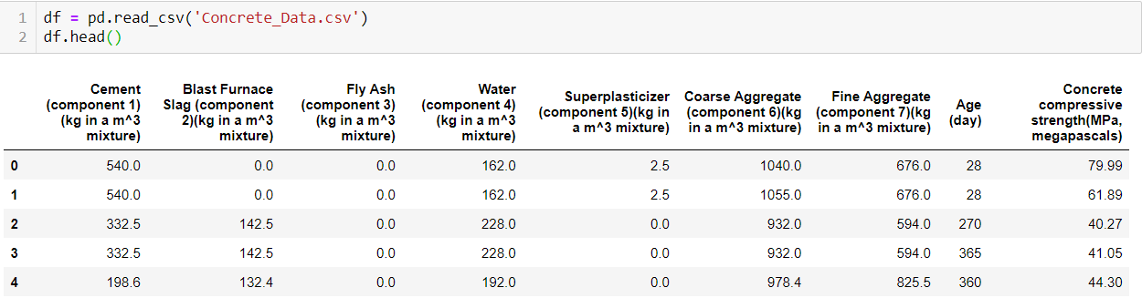

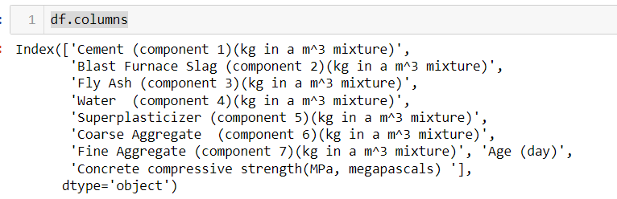
DATA EXPLORATION AND PREPROCESSING
Dataset and it’s characteristics
Shape of the Dataset
→ The dataset has 1030 Rows and 9 Columns.
Checking the column names of the dataset.
→ As mentioned, there are 9 columns in the dataset.

Slide 5
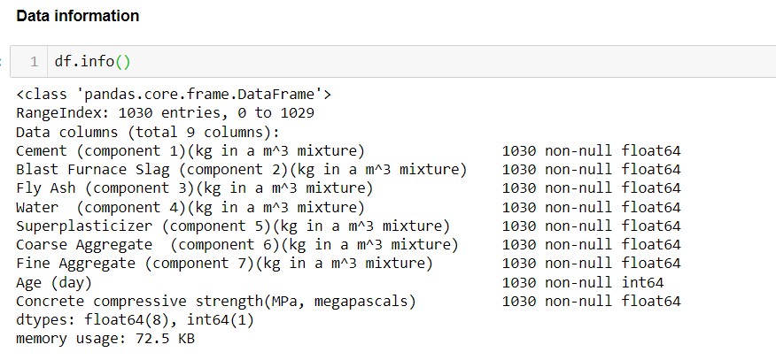
DATA INFORMATION (About the data types)
There are no null values in the dataset, based on the information 8 columns are of float data type and one column Age is of int data type.

Slide 6
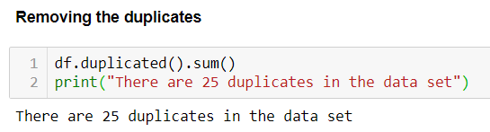
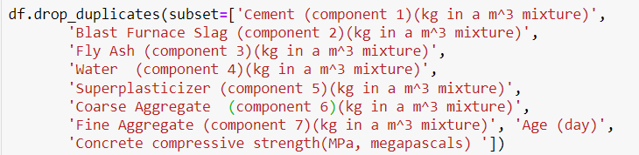
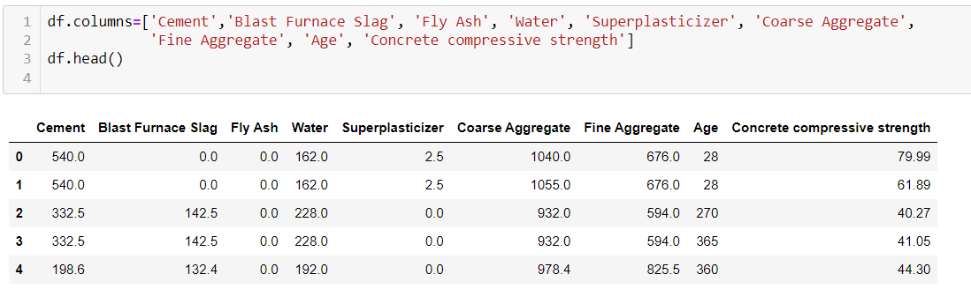
DATA CLEANING
Out Of 1030 Rows we have 25 duplicates in the data set.
Dropping the duplicates
After dropping, the dataset becomes 1005 Rows and 9 columns.
Renaming the columns for ease

Slide 7
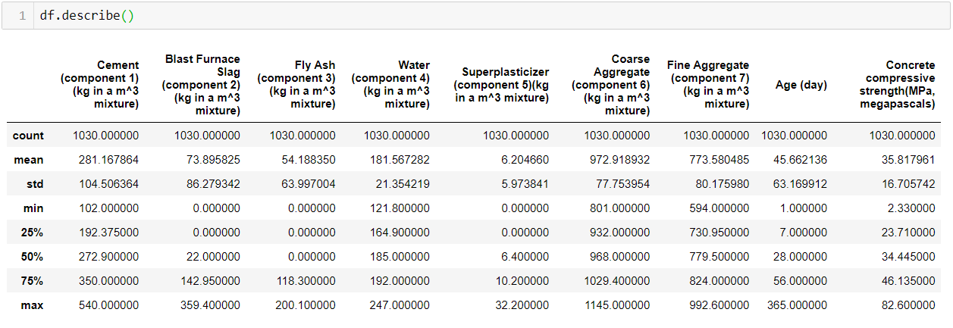
SUMMARY STATISTICS OF KEY CONCRETE PROPERTIES.
Summary statistics of the concrete properties after removing the duplicates

Slide 8
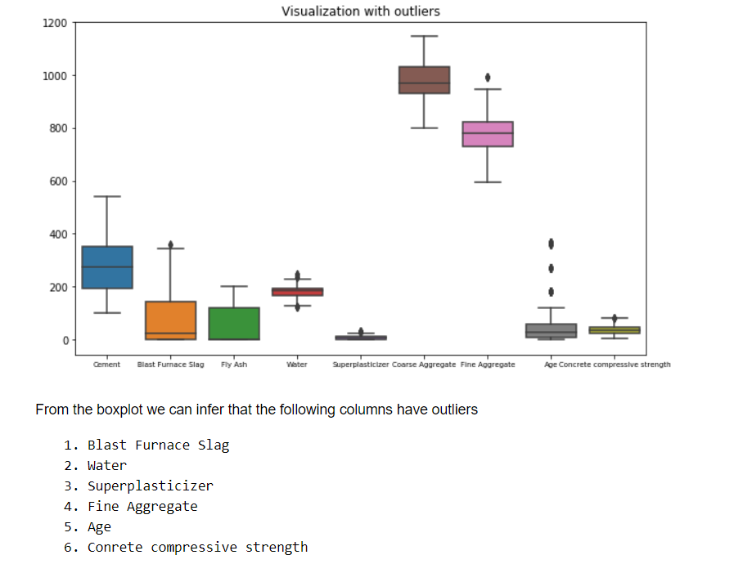
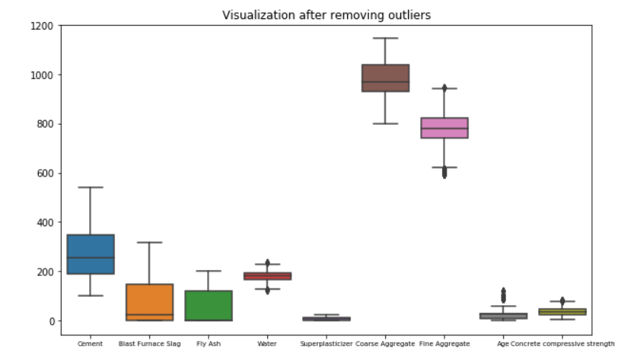
OUTLIER DETECTION

Slide 9
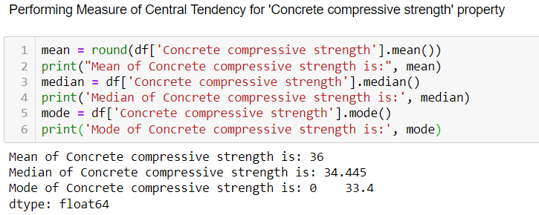
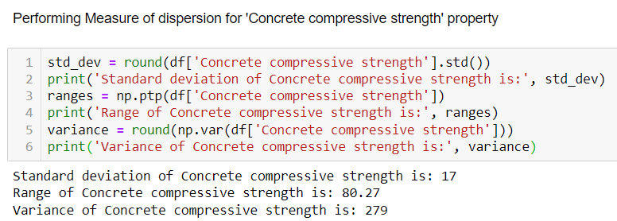
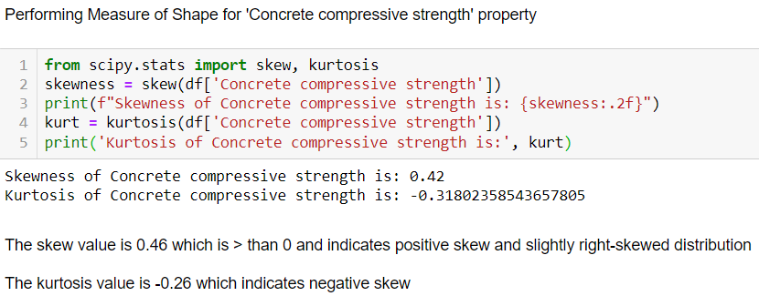
DATA ANALYSIS
Performing basic statics for Concrete Compressive strength – concrete property

Slide 10
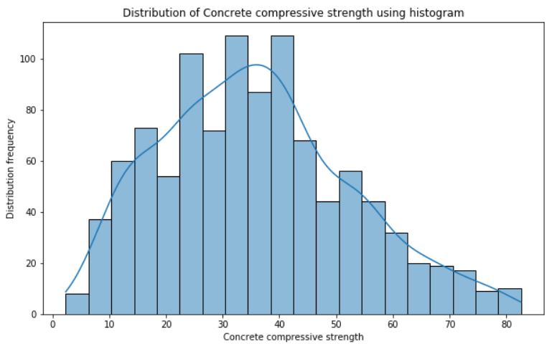
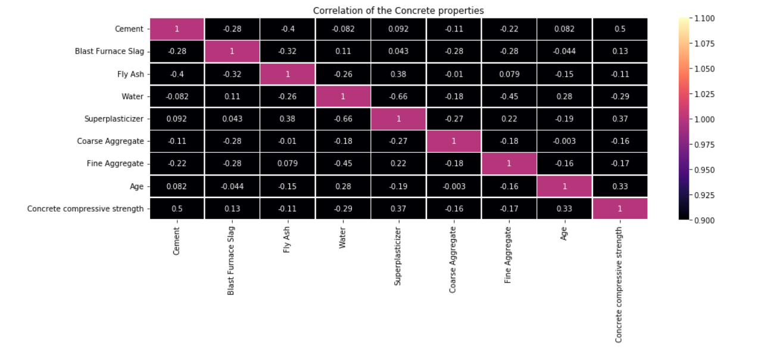
HISTOGRAM AND HEAT MAP
DISTRIBUTION OF CONCRETE COMPRESSIVE STRENGTH.
EXPLORING CORRELATION BETWEEN AGE AND CONCRETE COMPRESSIVE STRENGTH

Slide 11
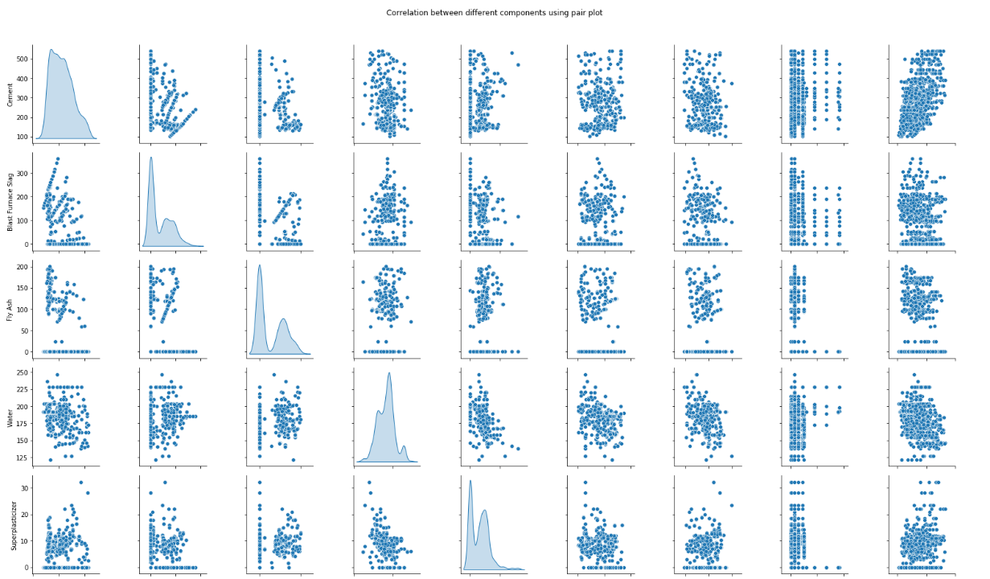
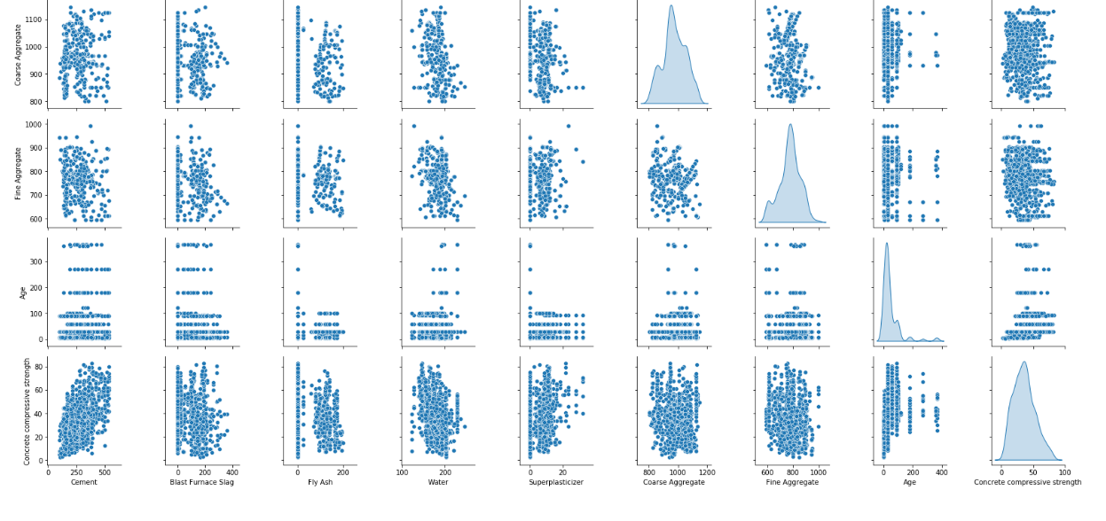
ANALYZING THE CORRELATION BETWEEN DIFFERENT CONCRETE PROPERTIES USING A PAIR PLOT

Slide 12
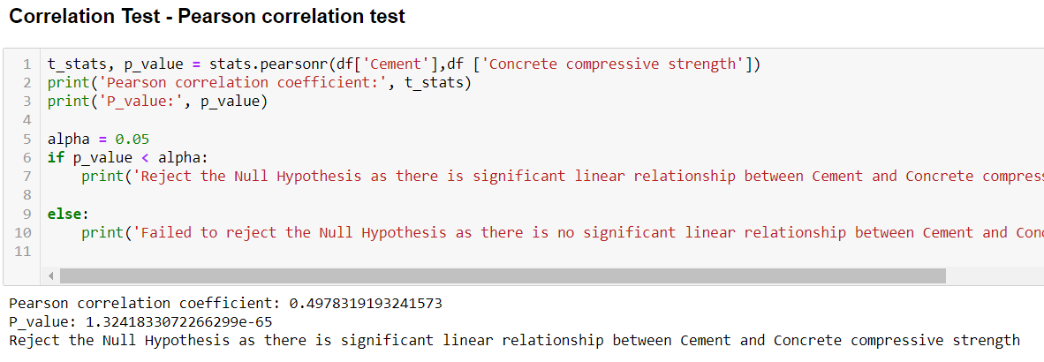
HYPOTHESIS TESTING
PEARSONR CORRELATION TEST BETWEEN CEMENT AND CONCRETE COMPRESSIVE STRENGTH
INFERENCES:
Pearson correlation test provides us with a conclusion that Cement and Concrete compressive strength are correlated with each and have a significant linear relationship.
As the amount of Cement increases, Concrete compressive strength also tends to increase

Slide 13
FINDINGS AND CONCLUSION
On analysing the data set there were total 6 outliers namely Blast Furnace Slag, Water, Superplasticizer, Fine Aggregate, Age and Concrete Compressive strength. For this case study I have removed the outliers.
My data analysis revolved around the concrete property namely Concrete Compressive Strength with other concrete properties like Cement and Age.
On conducting Pearson correlation test the following results were observed 0.4978 as the Pearson Correlation Coefficient and a Pvalue of 1.3241. These results indicate that there is a significant linear relationship between Cement and Concrete Compressive Strength. As the cement amount increases, the concrete compressive strength also increase.
Smith should consider the above understanding for selecting the material and mixture adjustments to improve and optimize strength.
On performing Shapiro Wilk Test for Concrete Compressive Strength and cement, we could clearly identify that these properties doesn’t follow normal distribution.
A non-parametric test Kruskal-Wallis test also provides low p-value which tends to reject the null hypothesis and concludes that there is a significant difference among the group in terms of Cement and Concrete Compressive Strength.
Smith needs to consider adjusting the Cement proportions in the concrete mixture to optimize the concrete compressive strength
Also, conducting regular data analysis by reviewing the data and patterns in-order to identify the quality issues or deviations can help Smith take timely actions.
Creating real-time insights about the concrete properties, performing advanced testing methods can help increase the quality of concrete.
The above analysis provides insights on the correlation between the concrete properties, factors affecting the concrete compressive strength and gives a foundation for Smith to understand how he can enhance the quality and customer satisfaction.

